Slide 1

Fit - o - Cracy
1

Slide 2
FIT-O-CRACY TEAM
2
Guide - Mr.Hariharan R.
Izna – 20BCE11021
Chandrika Sharma –20BCE11032
Vishvas Patel – 20BCE10993
Sambhav Mehta – 20BCE11033
Radheshyam Soni – 20BCE10994

Slide 3
3
ABOUT FIT-O-CRACY
It is a website created by our team to provide a platform to maintain physical well-being
Our website is made using Html, Tailwind CSS
We take physical data of user and recommend them a user specific workout and diet

Slide 4
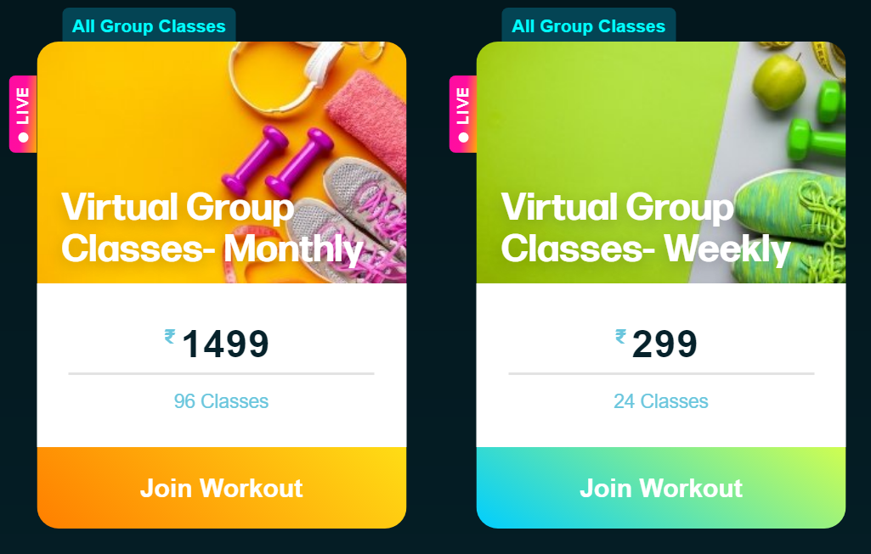
Existing work and limitations
4
1. Online workout sessions :
https://mycrush.fit
Problems:
Expensive
Not time flexible

Slide 5
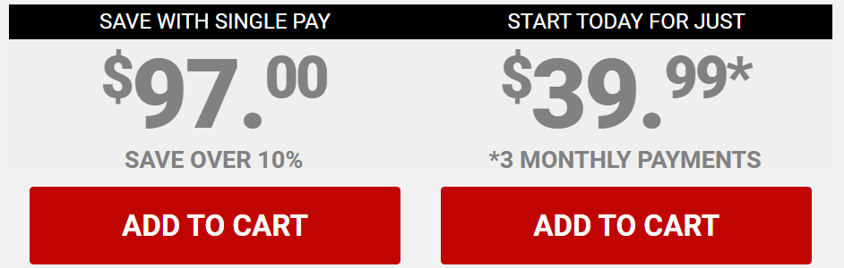
5
2. Online sites:
https://athleanx.com/
Problems:
Expensive
Not person specific
Doesn’t work for everyone

Slide 6
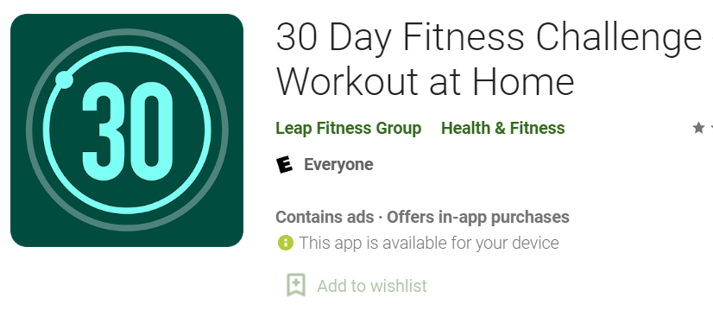
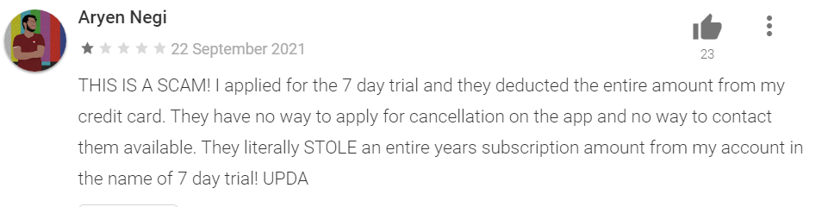
6
3. Applications :
Problems:
Expensive (sometimes)
Not person specific
False information regarding fitness
Annoying advertisements
Not enough knowledge
https://play.google.com/store/apps/details?id=com.popularapp.thirtydayfitnesschallenge&hl=en_IN&gl=US

Slide 7
Website for whom?
7
People with busy schedule
01
02
Not enough resources
03
No proper knowledge

Slide 8



8
Details about site
Languages used:
HTML
Tailwind CSS
JavaScript
Responsive website
Visual code studio used for developing

Slide 9
9
Proposed work and methodology
Website will provide user a personalized plan using provided information :
Height
Weight
Age
It will calculate BMI(Body Mass Index) which will tell their body type and suggest the right workout with a diet plan
It will be free of cost

Slide 10


10
Frameworks used
Bootstrap - http://getbootstrap.com/
jQuery - http://jquery.com/
Modernizr - http://modernizr.com/
Google Fonts - https://www.google.com/fonts/
Icons - http://flaticon.com
animate.css - http://daneden.me/animate
Images - https://www.google.com/imghp?hl=en

Slide 11
11
Components
of
our website

Slide 12
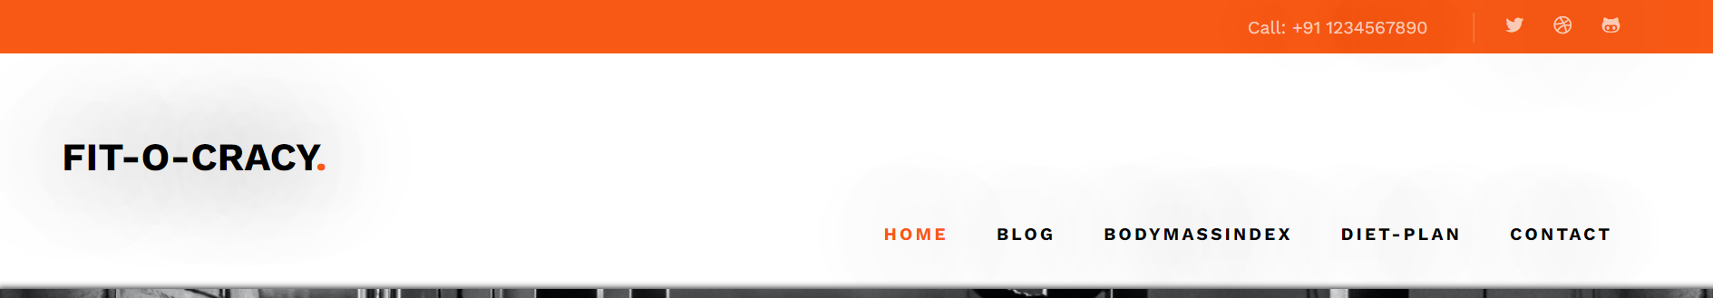
12
Header and Navigation bar
Hovering effect navigation bar
Highlights the page
Smooth transition

Slide 13
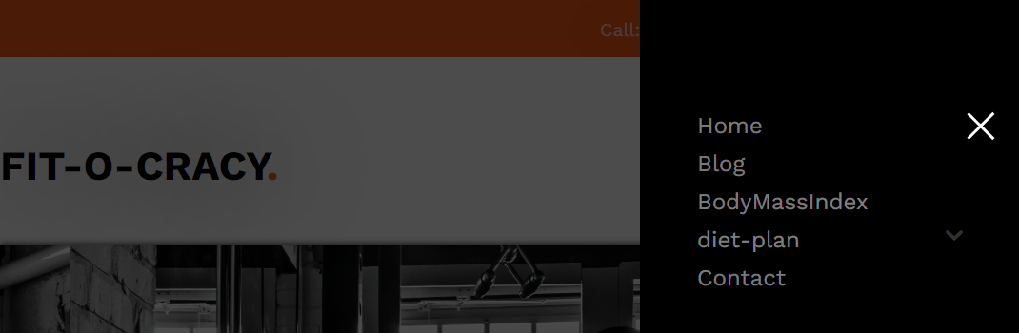
13
This is navigation after affected by change in site resolution

Slide 14
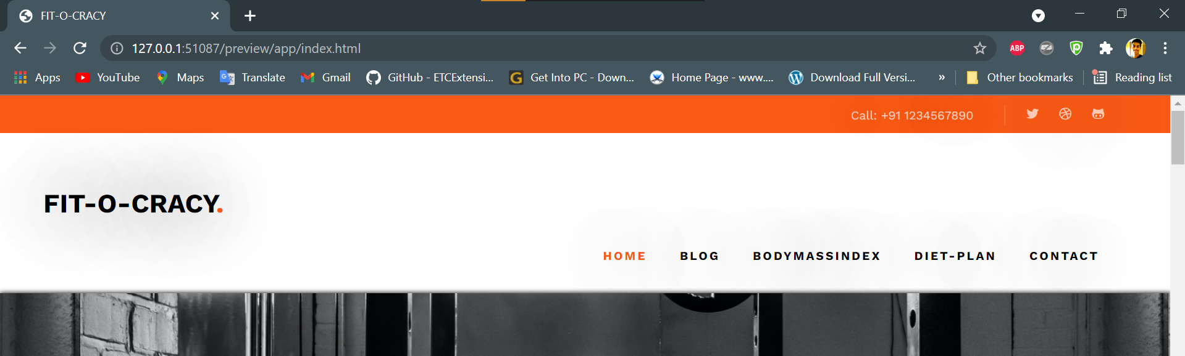
14
Responsive site
Exceptional UX(user experience)
No throttling
Works differently for tab , mobile and laptop
Laptop view

Slide 15
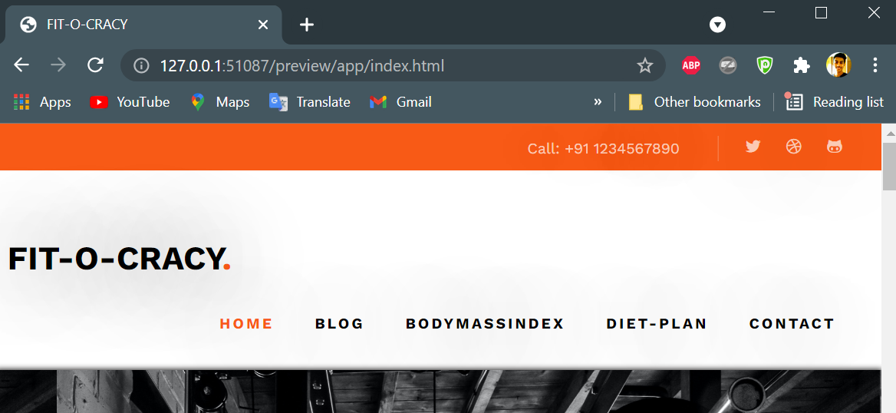
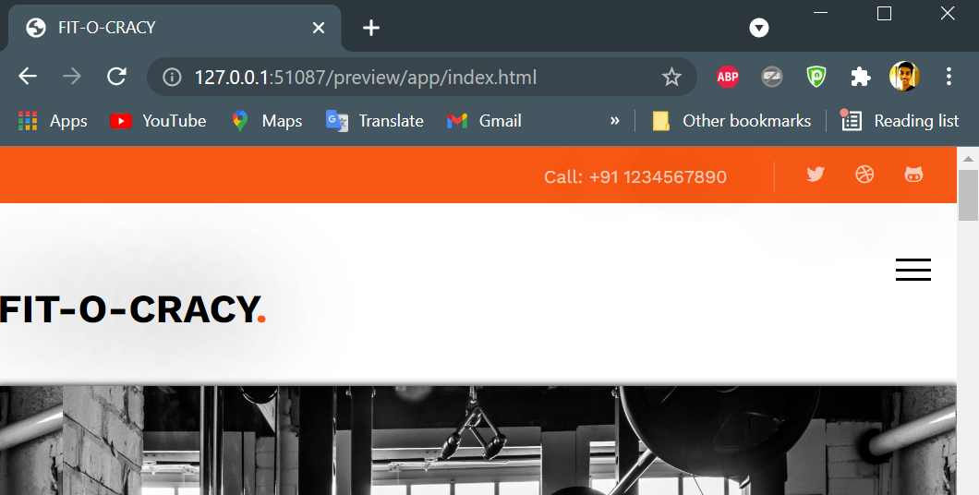


15
Tab view
Phone view

Slide 16
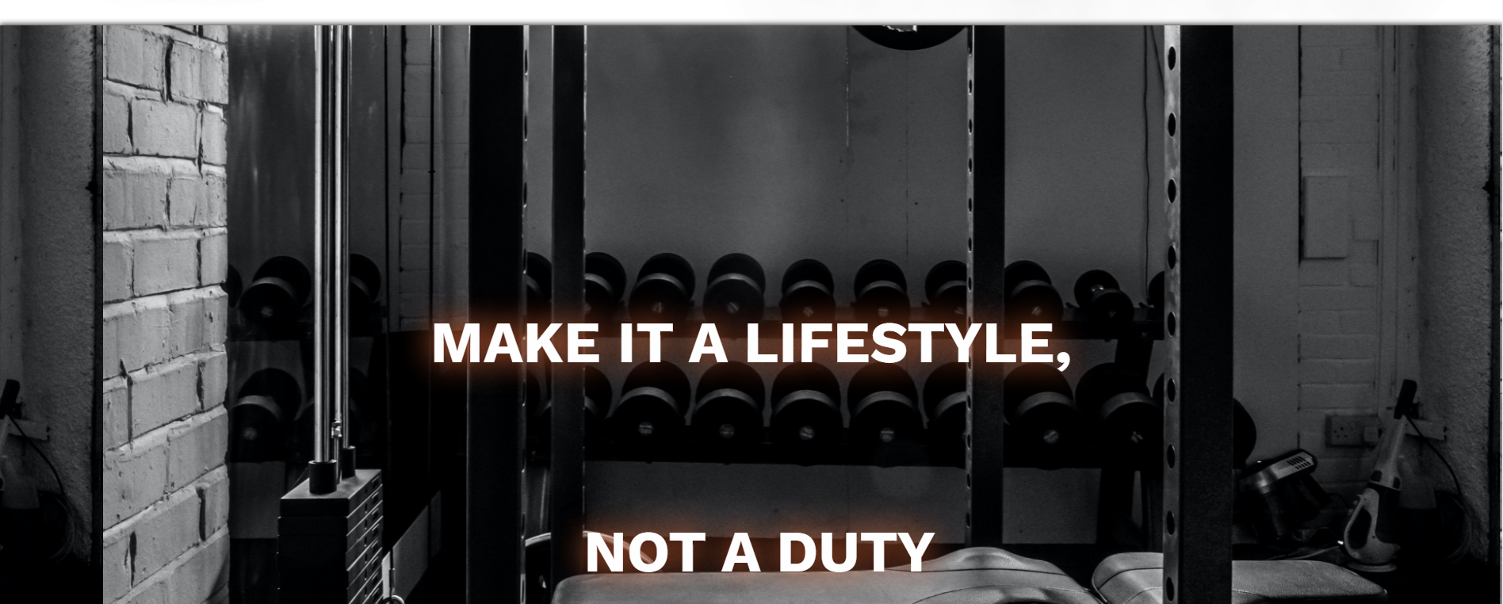
16
Card style
Shadow effect and modern highlights
Laptop view

Slide 17
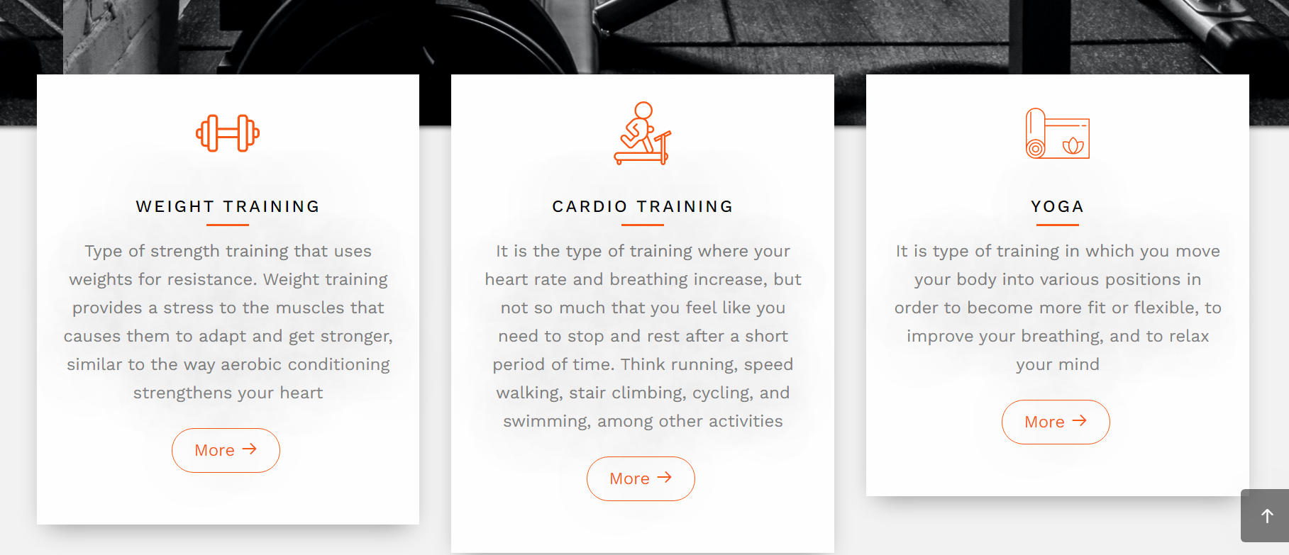
17
Modern style cards and animated effects

Slide 18
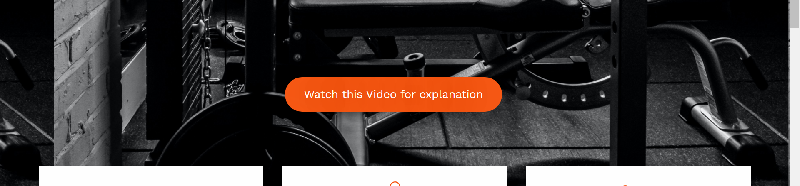
18
Video embedding

Slide 19
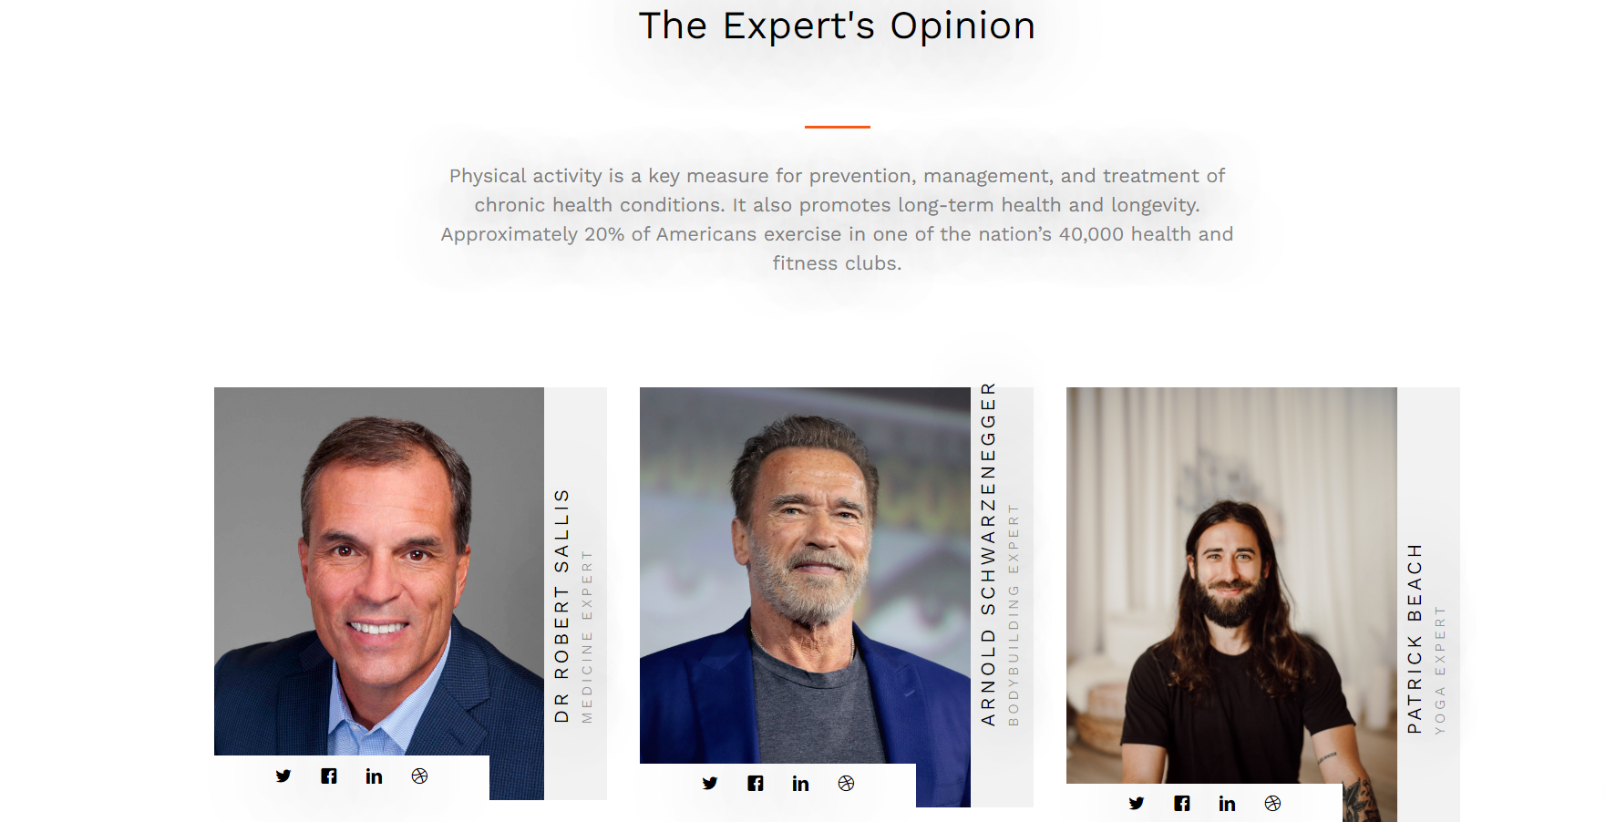
19
Responsive and modern social portfolio

Slide 20
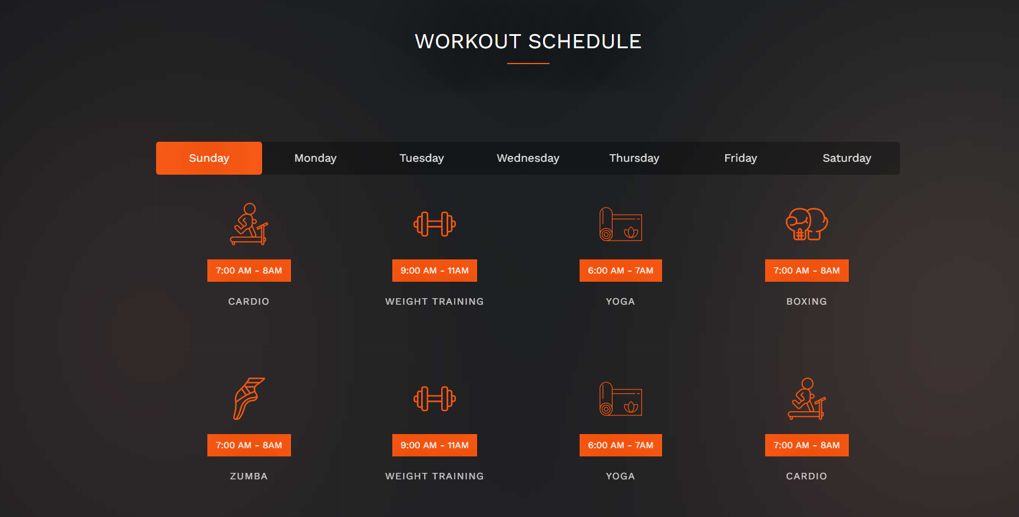
20
Animated schedule table

Slide 21
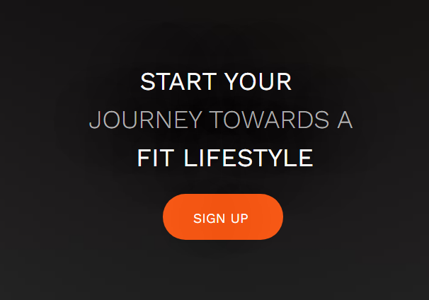
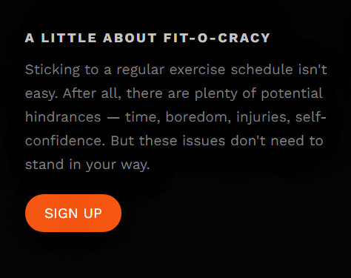
21
Call-to-Actions

Slide 22
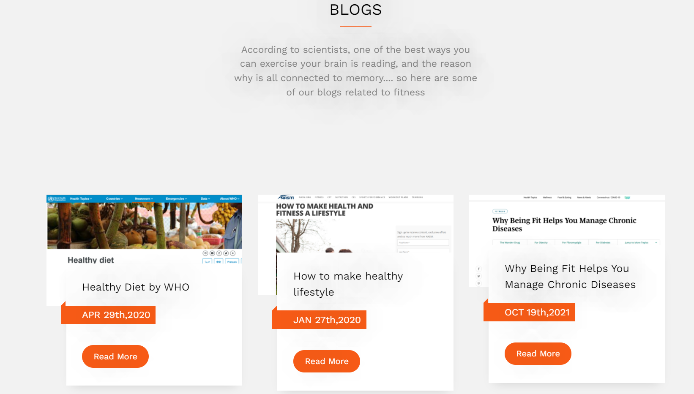
22
Modern style blog displays

Slide 23
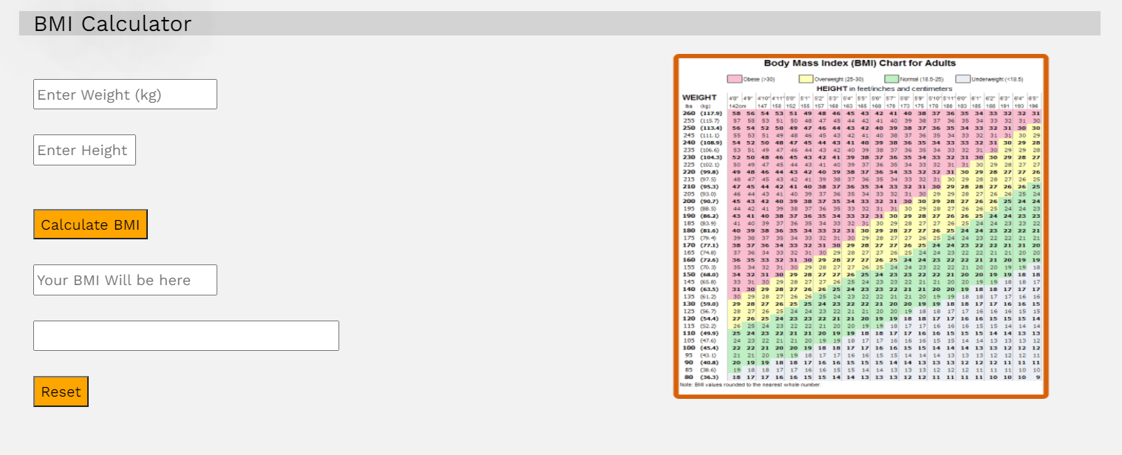
Body mass index calculator
23
useful and easy to use
With graph to see where your result falls

Slide 24
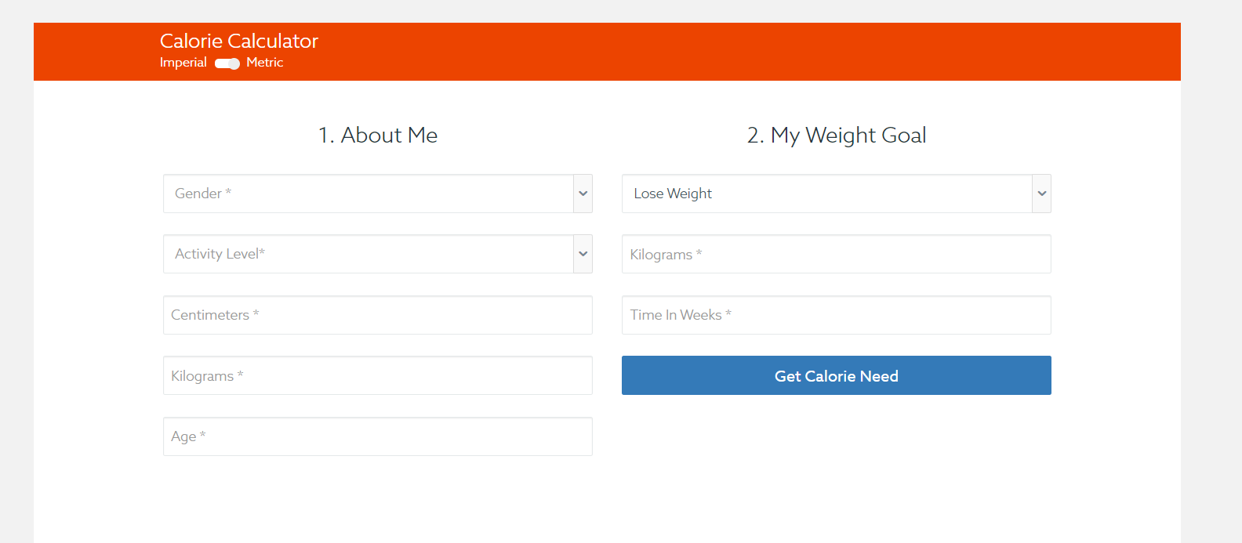


Required calorie calculator
24
Uses both imperial and metric units
Gives you accurate data on required calories

Slide 25
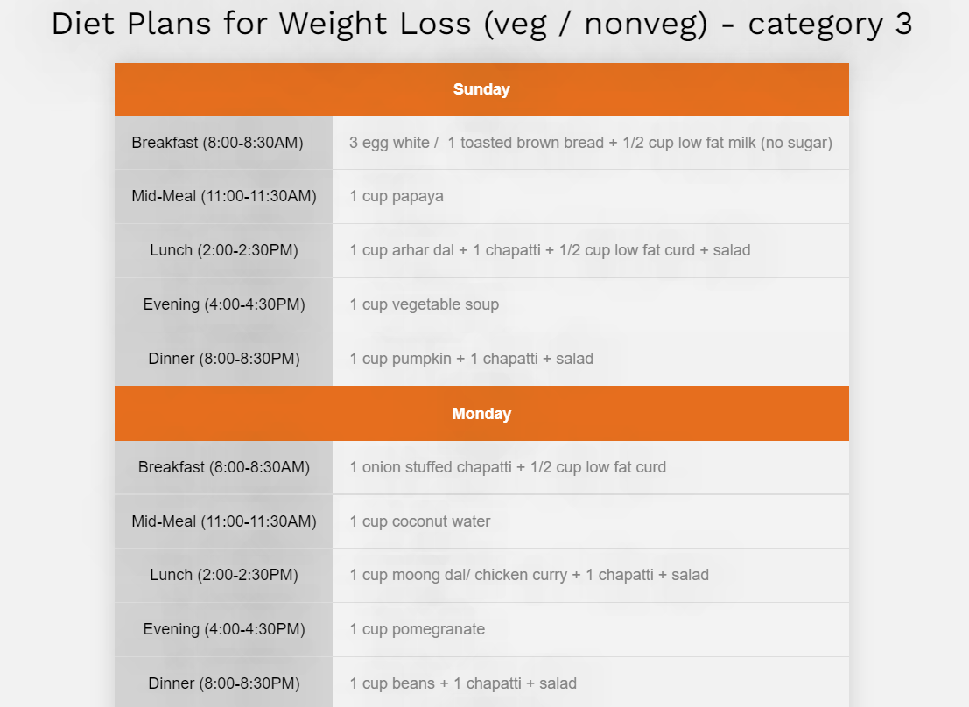
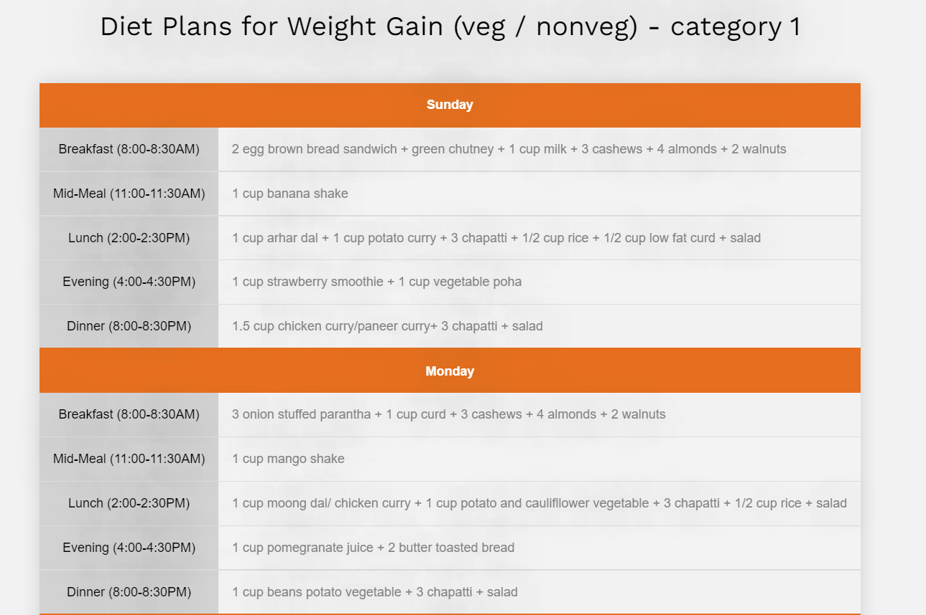
Diet plan
25
Professional doctor approved
Gives plan according to your BMI(Body Mass Index) category

Slide 26
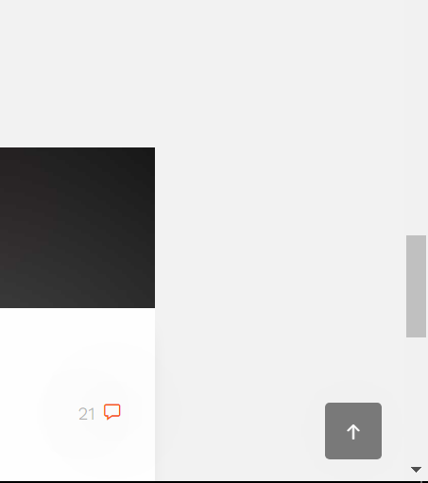
26
Page beginning jump arrow
useful and handy
Small and almost camouflaging

Slide 27
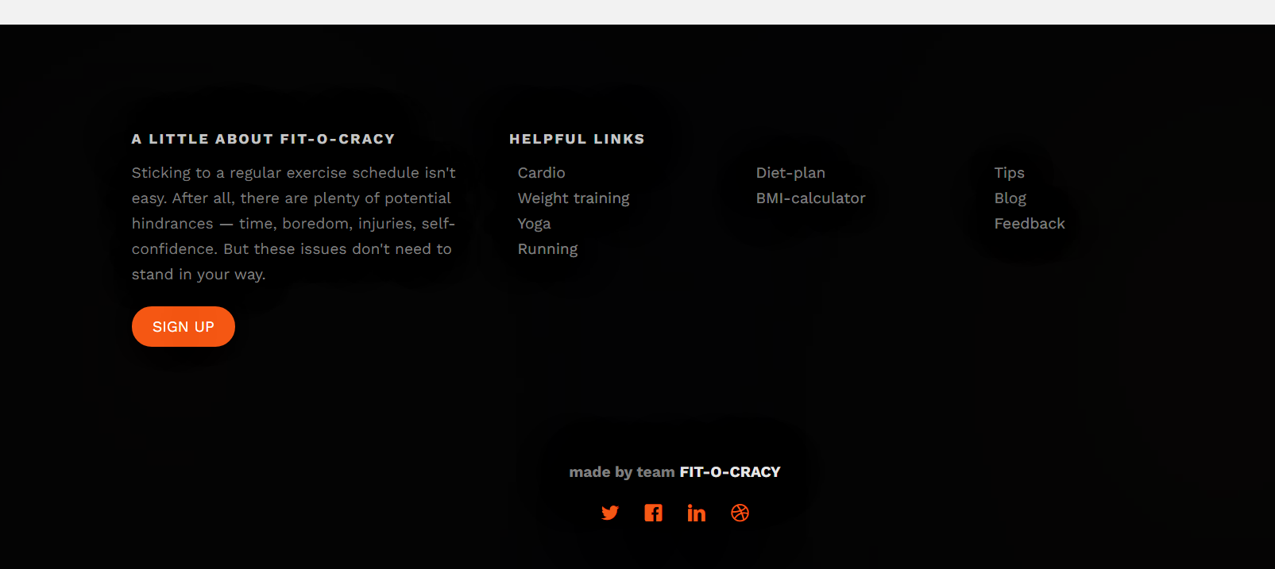
27
footer
Engaging and eye-catching footer with useful links
Social handles and feedback provided

Slide 28
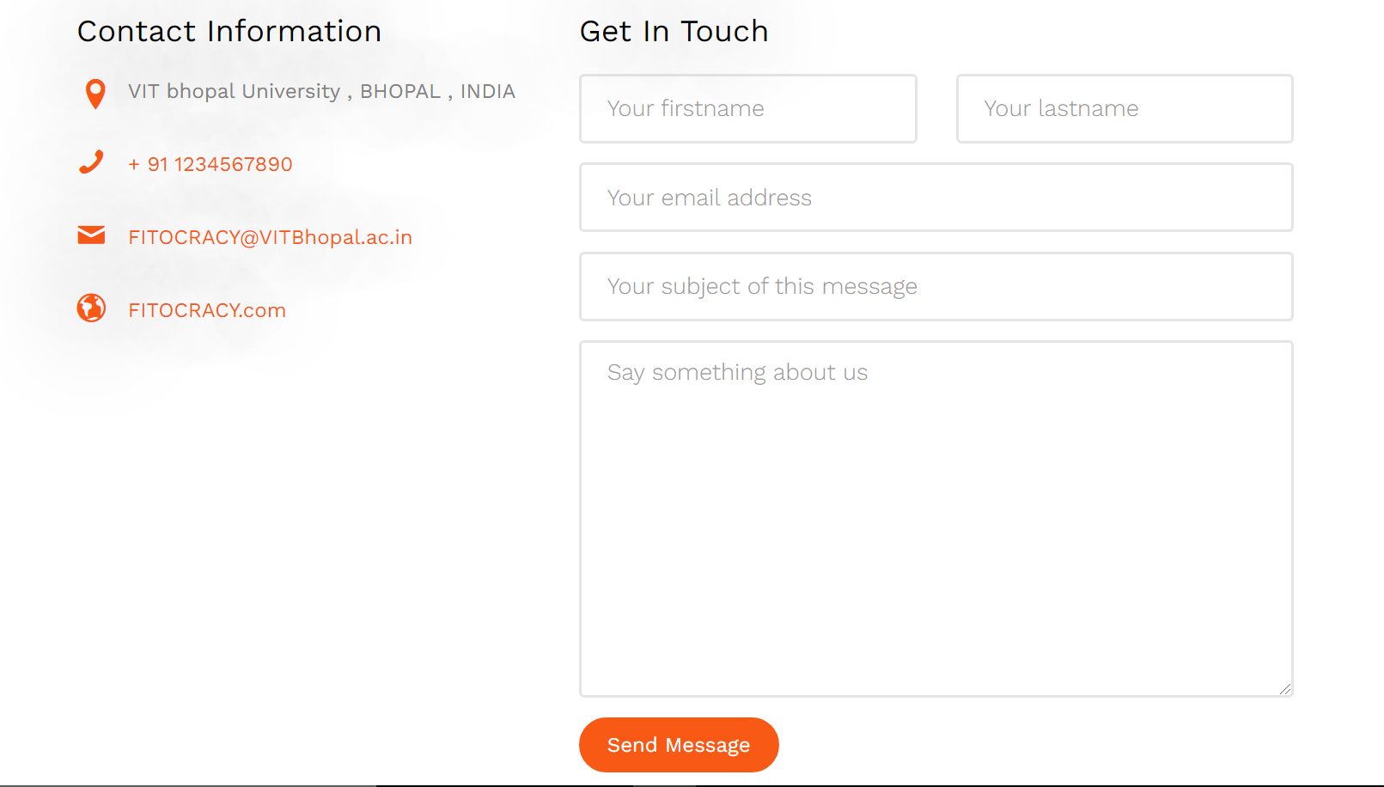
28
Contact forms with thank you page
Standard feedback form and Contacts
Smooth animation

Slide 29



Thank You
29

